Slide 1
Credit One
Resolving the increase in customers with Data Analysis and Python

Slide 2
Our goals
We are trying to understand how much credit to allow someone for our credit card
We are also trying to understand if at the very least should be approved or not for our card.
With python we can analyze the dataset and use machine learning to predict these questions

Slide 3
The BADIR Framework (from Jain and Sharma, Behind Every Good Decision, chapter 4)
We will be using the BADIR framework to understand this problem. BADIR is an acronym
That stand for:
B- Business question
A- Analysis plan
D- Data collection
I- Insights
R- Recommendation

Slide 4
Business Question-
How to figure out how much credit should we allow customers to have, and if they should be approved or not for our card.
Analysis Plan-
We will use the dataset provided to see if different factors affect a person’s credit score. Our dataset includes: the amount of given credit to customers, their gender, their marital status,their age, their history of past payments (if there was any delays with their payments) , their bill statements, and their previous bill payments.
Data Collection-
The data was collected from Yeh, I. C., & Lien, C. H. (2009). The comparisons of data mining techniques for the
predictive accuracy of probability of default of credit card clients. Expert Systems with Applications, 36(2), 2473-2480.
The data needs to be changed to a numeric type for our python applications. This can be cleaned and changed using python.
Insights-
We can use the data from the customers and test them on machine learning algorithms to see if there are clear conclusions that we can find.
Recommendations-
With our results we easily respond to the increased amount of customers we are gaining.

Slide 5
Data source
The data was collected from Yeh, I. C., & Lien, C. H. (2009). The comparisons of data mining techniques for the
predictive accuracy of probability of default of credit card clients. Expert Systems with Applications, 36(2), 2473-2480.
We can use their research about customers payments to predict our own customers and that could help with pre approving our customers and it would provide us with an estimate for a credit that we could give to them.
We will also use various python libraries to help clean and analyze this data.

Slide 6
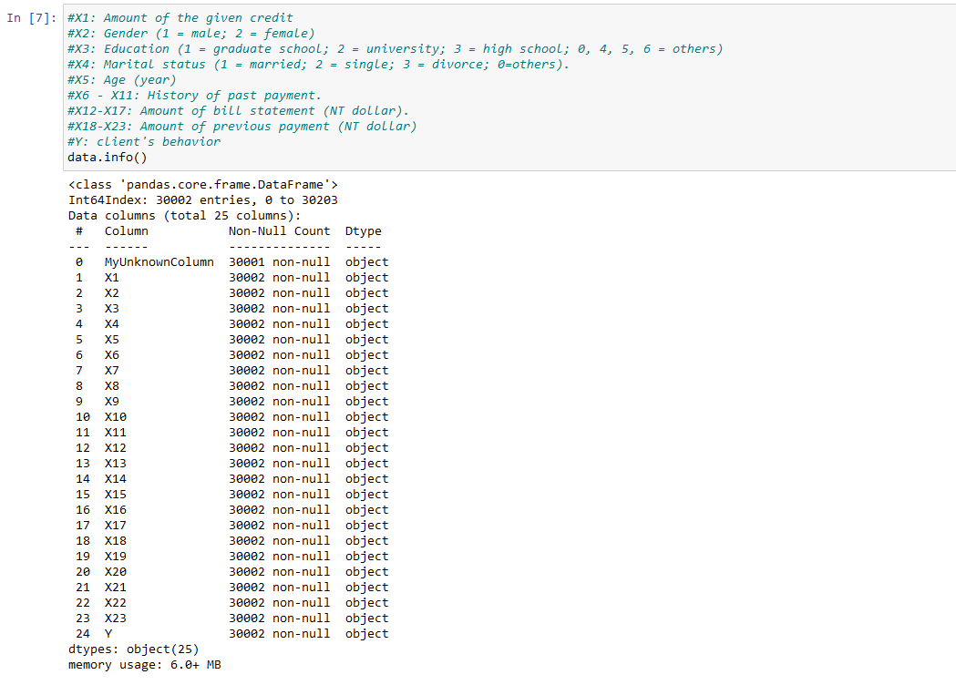
A preview of the data we are working with

Slide 7
Managing the Data
We can use the pandas library (https://pandas.pydata.org/pandas-docs/stable/pandas.pdf) +
pandas_profiling library (https://pypi.org/project/pandas-profiling/) to manage this data.
We will also use the scikit-learn library (https://scikit-learn.org/stable/#) to use machine learning to predict our goal results

Slide 8
Issues with the Dataset
We need to clean the dataset to so that it will be more usable for our machine Learning methods. We will have to change some of the data to be numerical (an integer type) as it is currently an object based data (a string type).
There is also a missing row in the dataset that we will deal with

